Slide 1
Introduction of PF (Performance Forecasting)
@Xun

Slide 2
Use Cases
PF Background – two use cases
Advertisers select the query criteria based on their experience and search the inventory. After reviewing the inventory list, they which inventory to book.
Advertisers provide the basic (high level) query criteria and creatives to system. The system finds the most relevant inventory for the creatives that match the criteria.
The Option 2) is getting more and more attention because of privacy concerns and government policies. Performance Forecasting (PF) is the application, and it is built on top of DIN model.

Slide 3
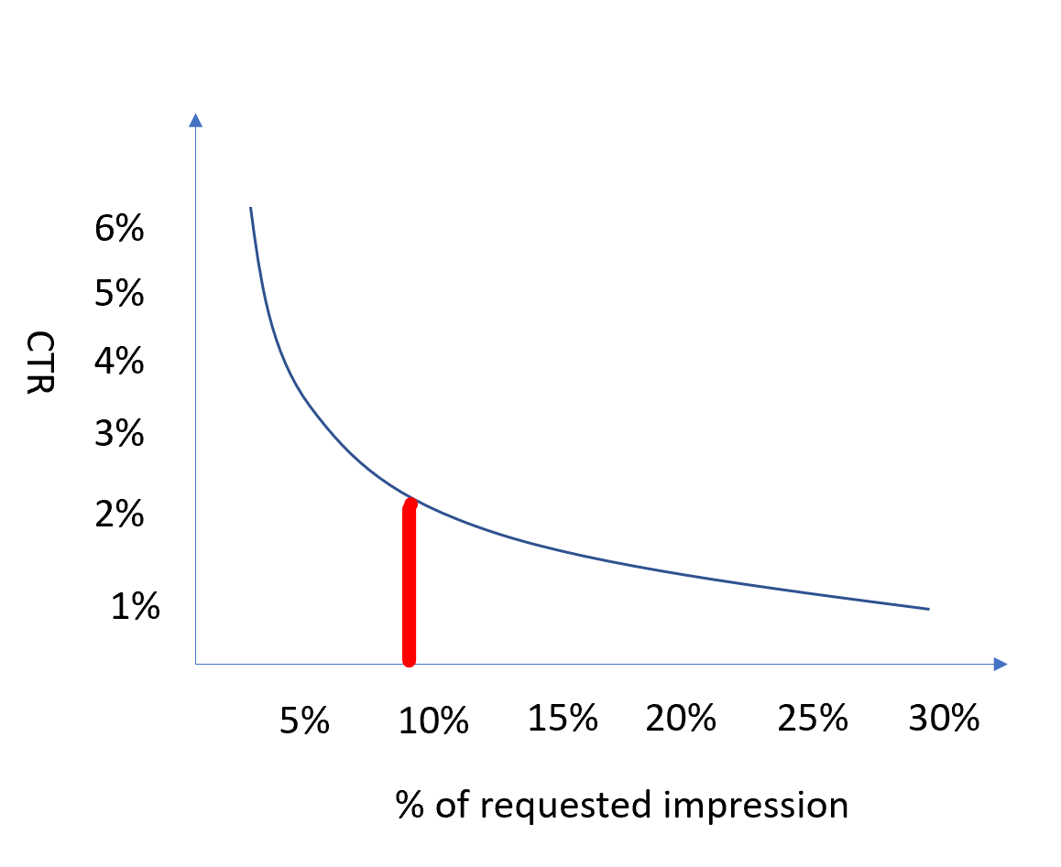
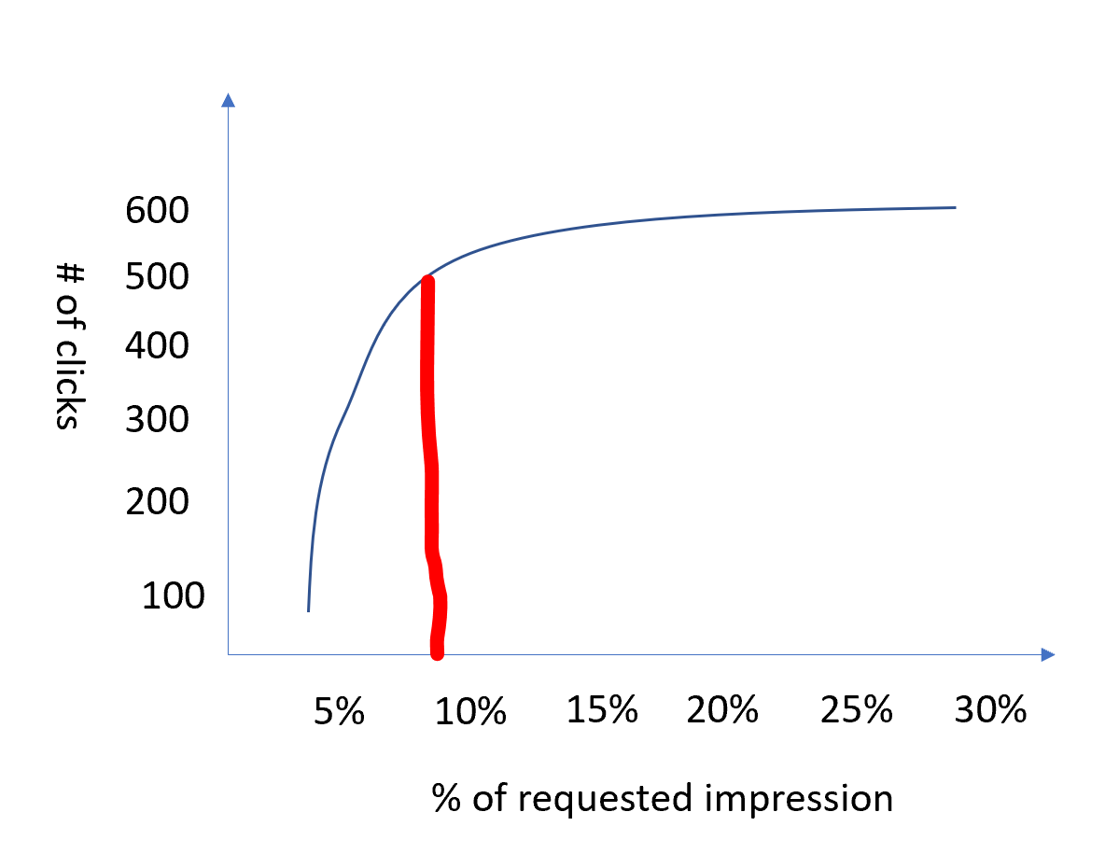
PF UI

Slide 4
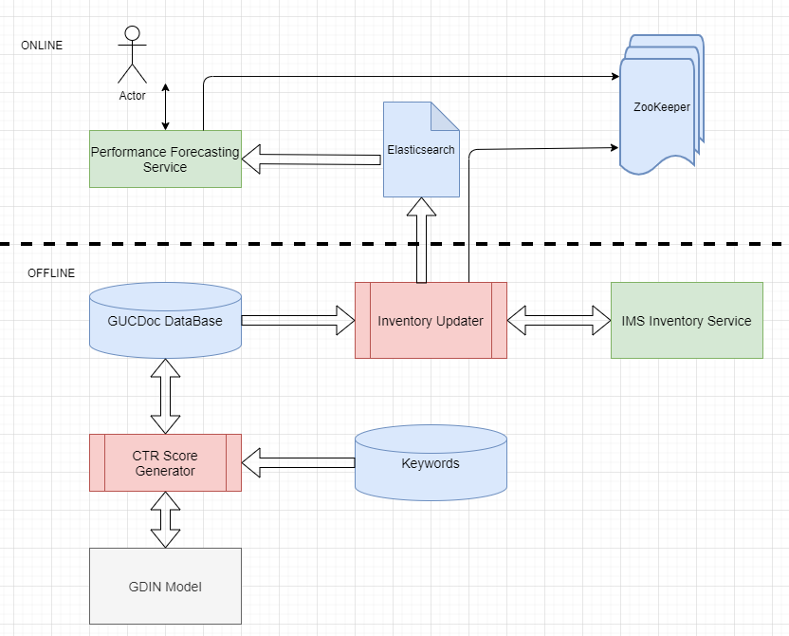
PF Architecture

